Slide 1
NFT Marketplace Project
Supervised by Dr. Hakan Ayral
NFTEAM
Ahmed Youssef 117200027
Sadiq Tijjani 119200113
Baris Tonbul 117200054

Slide 2
1
2
3
Abstract
Problem Definition
Introduction
CONTENTS OF THIS PRESENTATION
4
Proposed Solution
5
6
7
8
Methodology
Risk-Cost Analysis
Project Timeline
Possible Outcomes

Slide 3
Abstract
1
Overview of our topic

Slide 4




Abstract
Buyers
Sellers
Meeting Point For Trade
User Friendly Interface
Digital Ownership
Blockchain Fortified Exchange

Slide 5
Problem Definition
2
Laying out the perceived problem

Slide 6
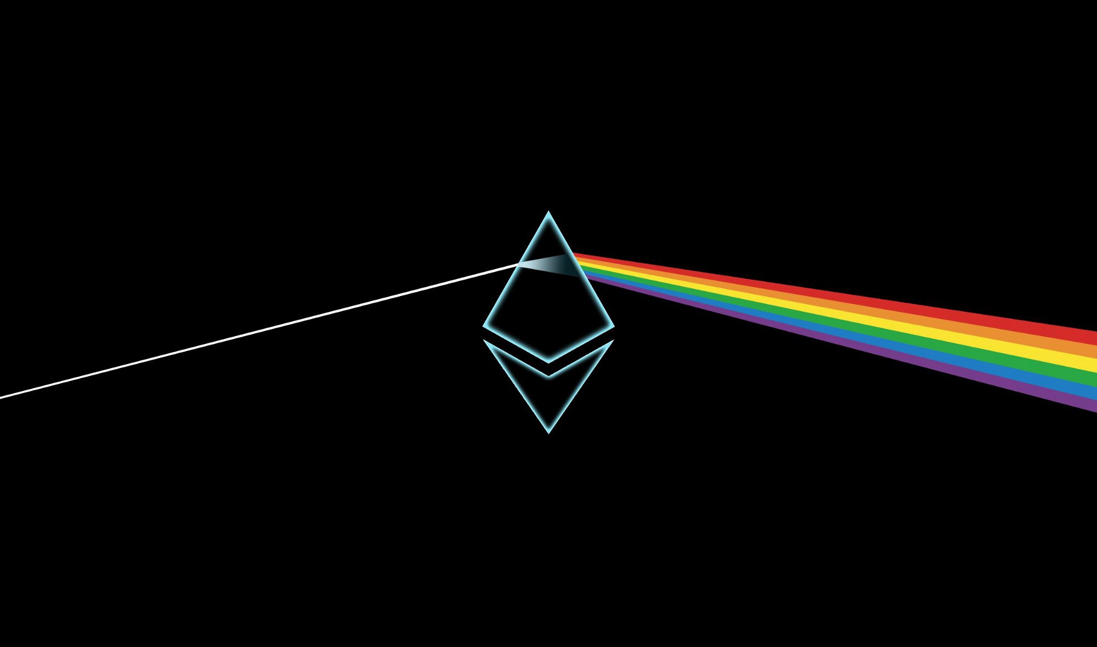
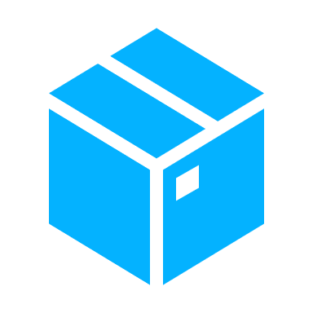

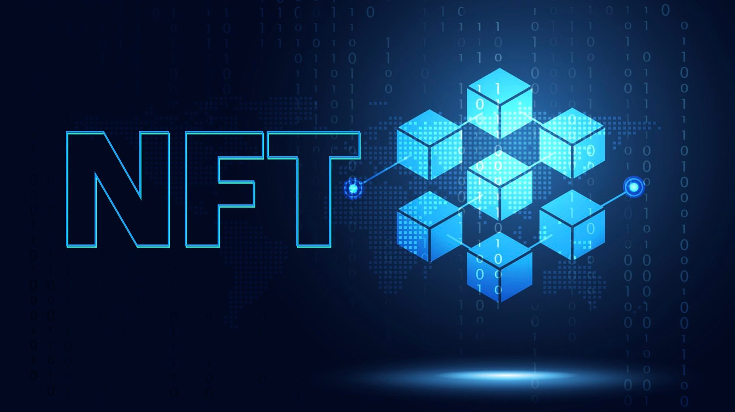

Problem Definition
Emergence Of Blockchain Technology
Ownership Of Digital Assets
Increase in Value of Unique Tokens

Slide 7
Introduction
3
Intro to our project

Slide 8
Overview Of Concepts
There are a few questions you may be asking at this point:
What is a non-fungible token(NFT)?
Why are NFTs valuable?
What is a Marketplace?
What can NFTs be traded for?

Slide 9

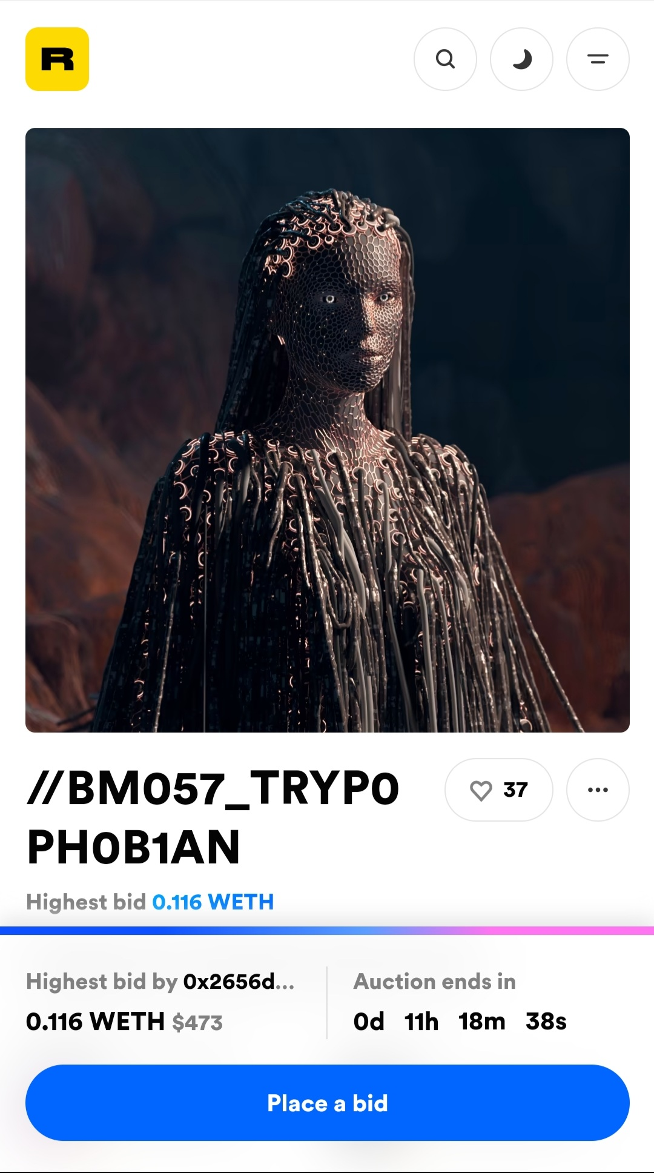
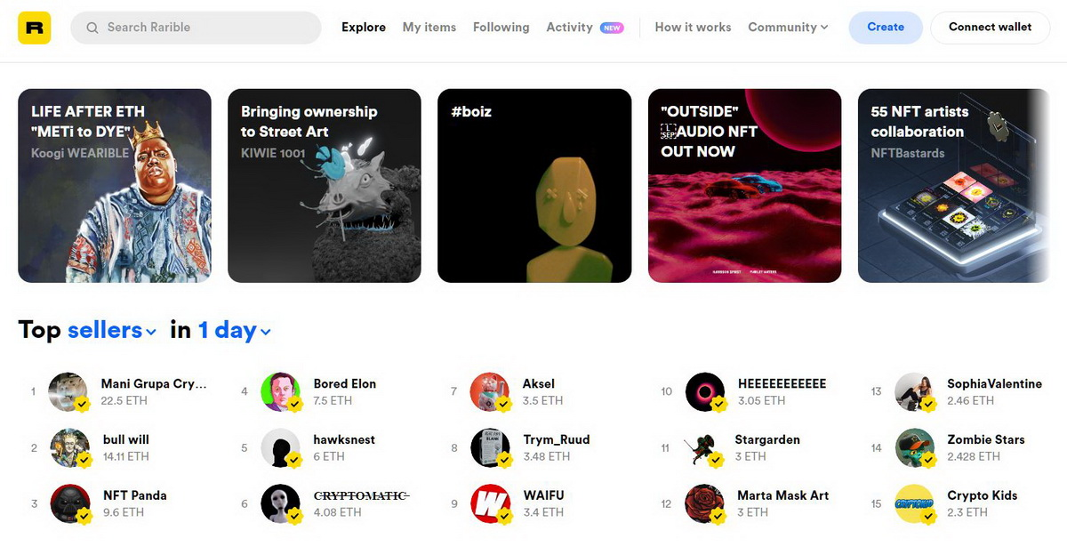
Previous Works

Slide 10
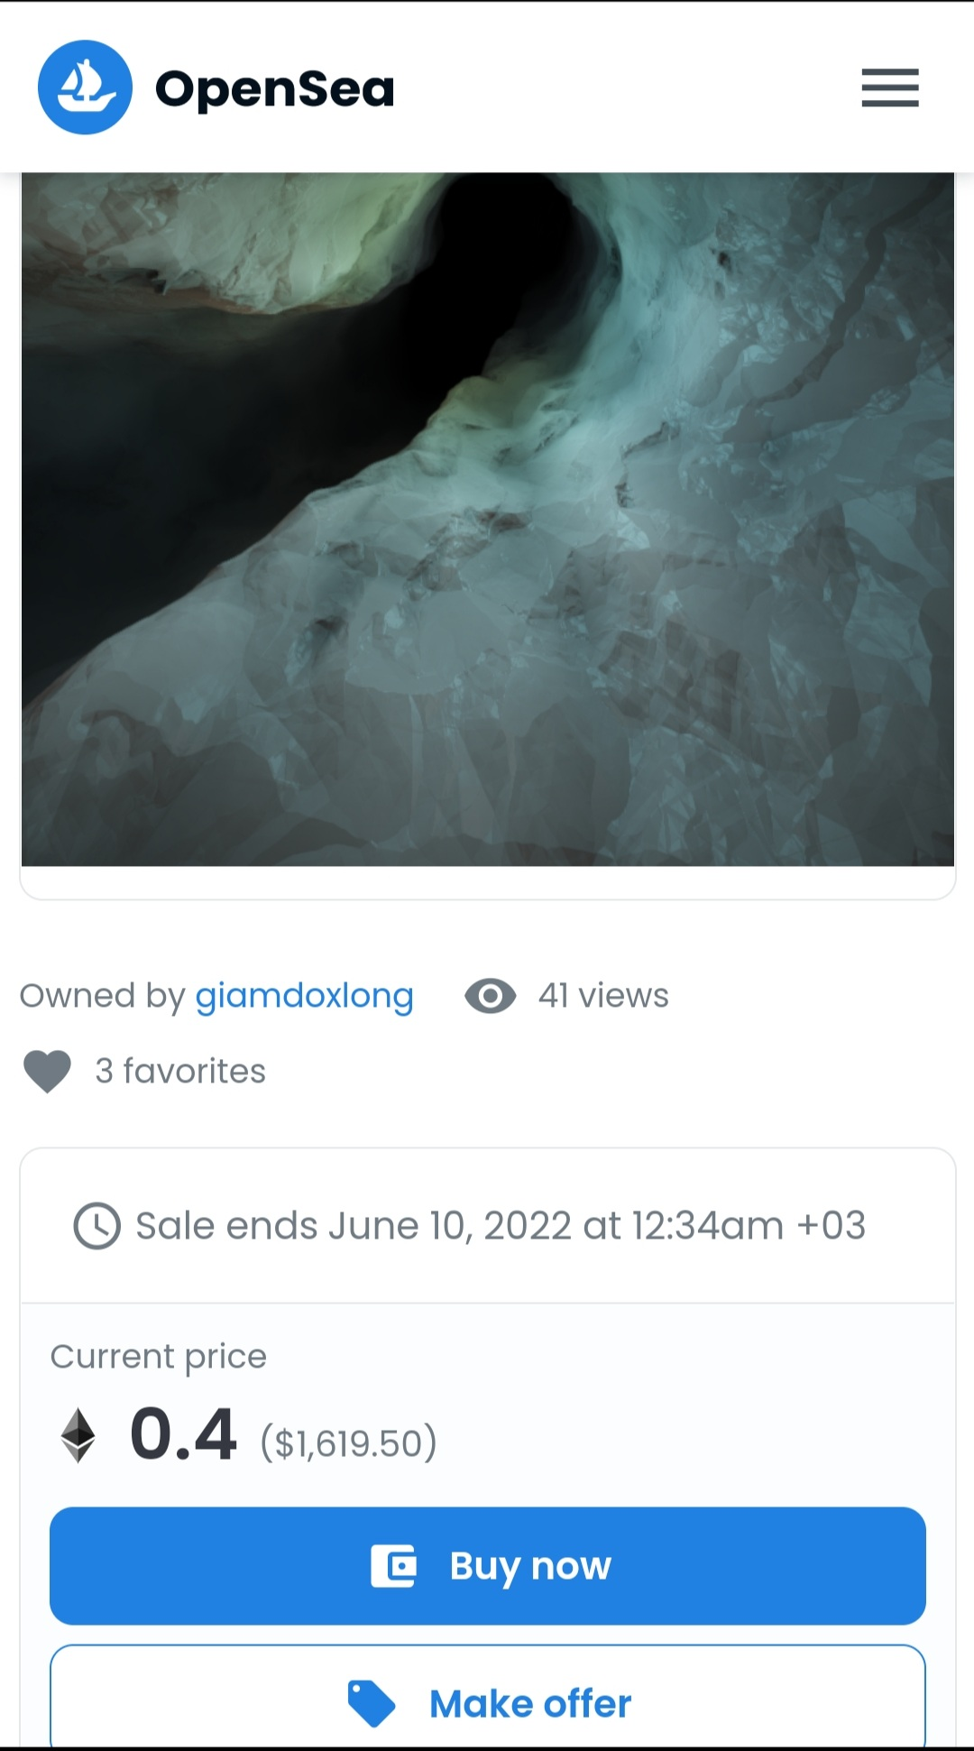
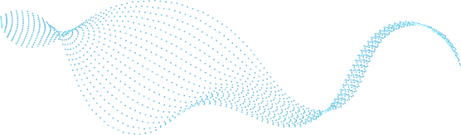
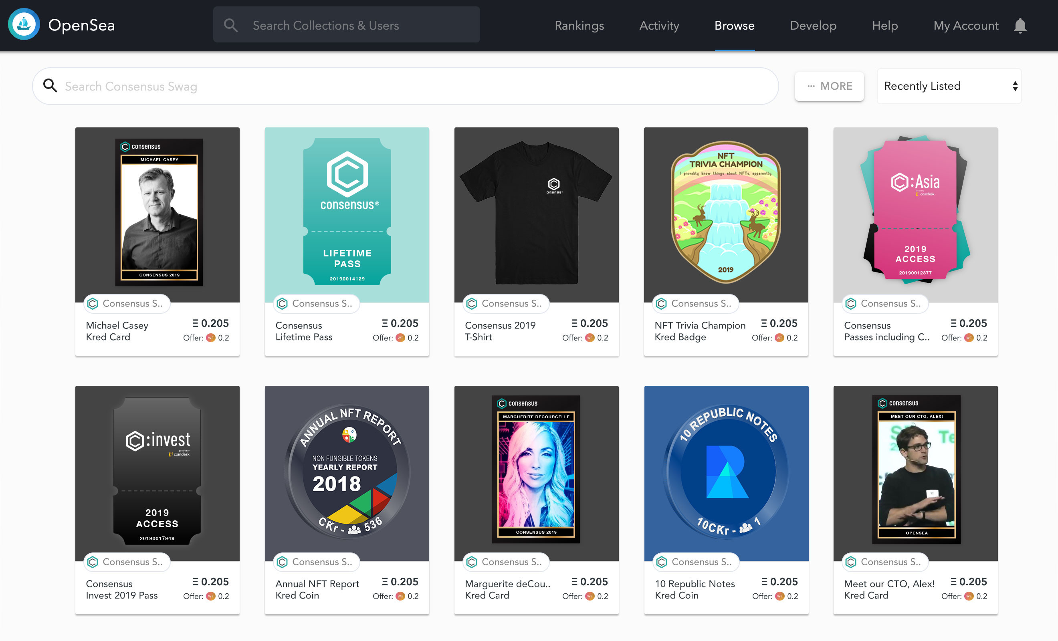
Previous Works

Slide 11
Proposed Solution
4
Laying out our proposed solution

Slide 12
Solution Design
Proposed Solution
NPM
Solidity
HTML5
Hard-Hat
Next.js
Tailwind CSS
IPFS
Meta-mask
Polygon

Slide 13

NPM
package manager for the JavaScript programming language.

Slide 14
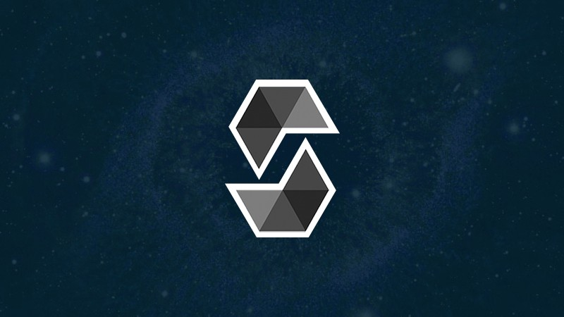
Solidity
Object Oriented programming language for writing smart contracts.

Slide 15

HTML5
Markup Language used to structure and present content on the world wide web.

Slide 16
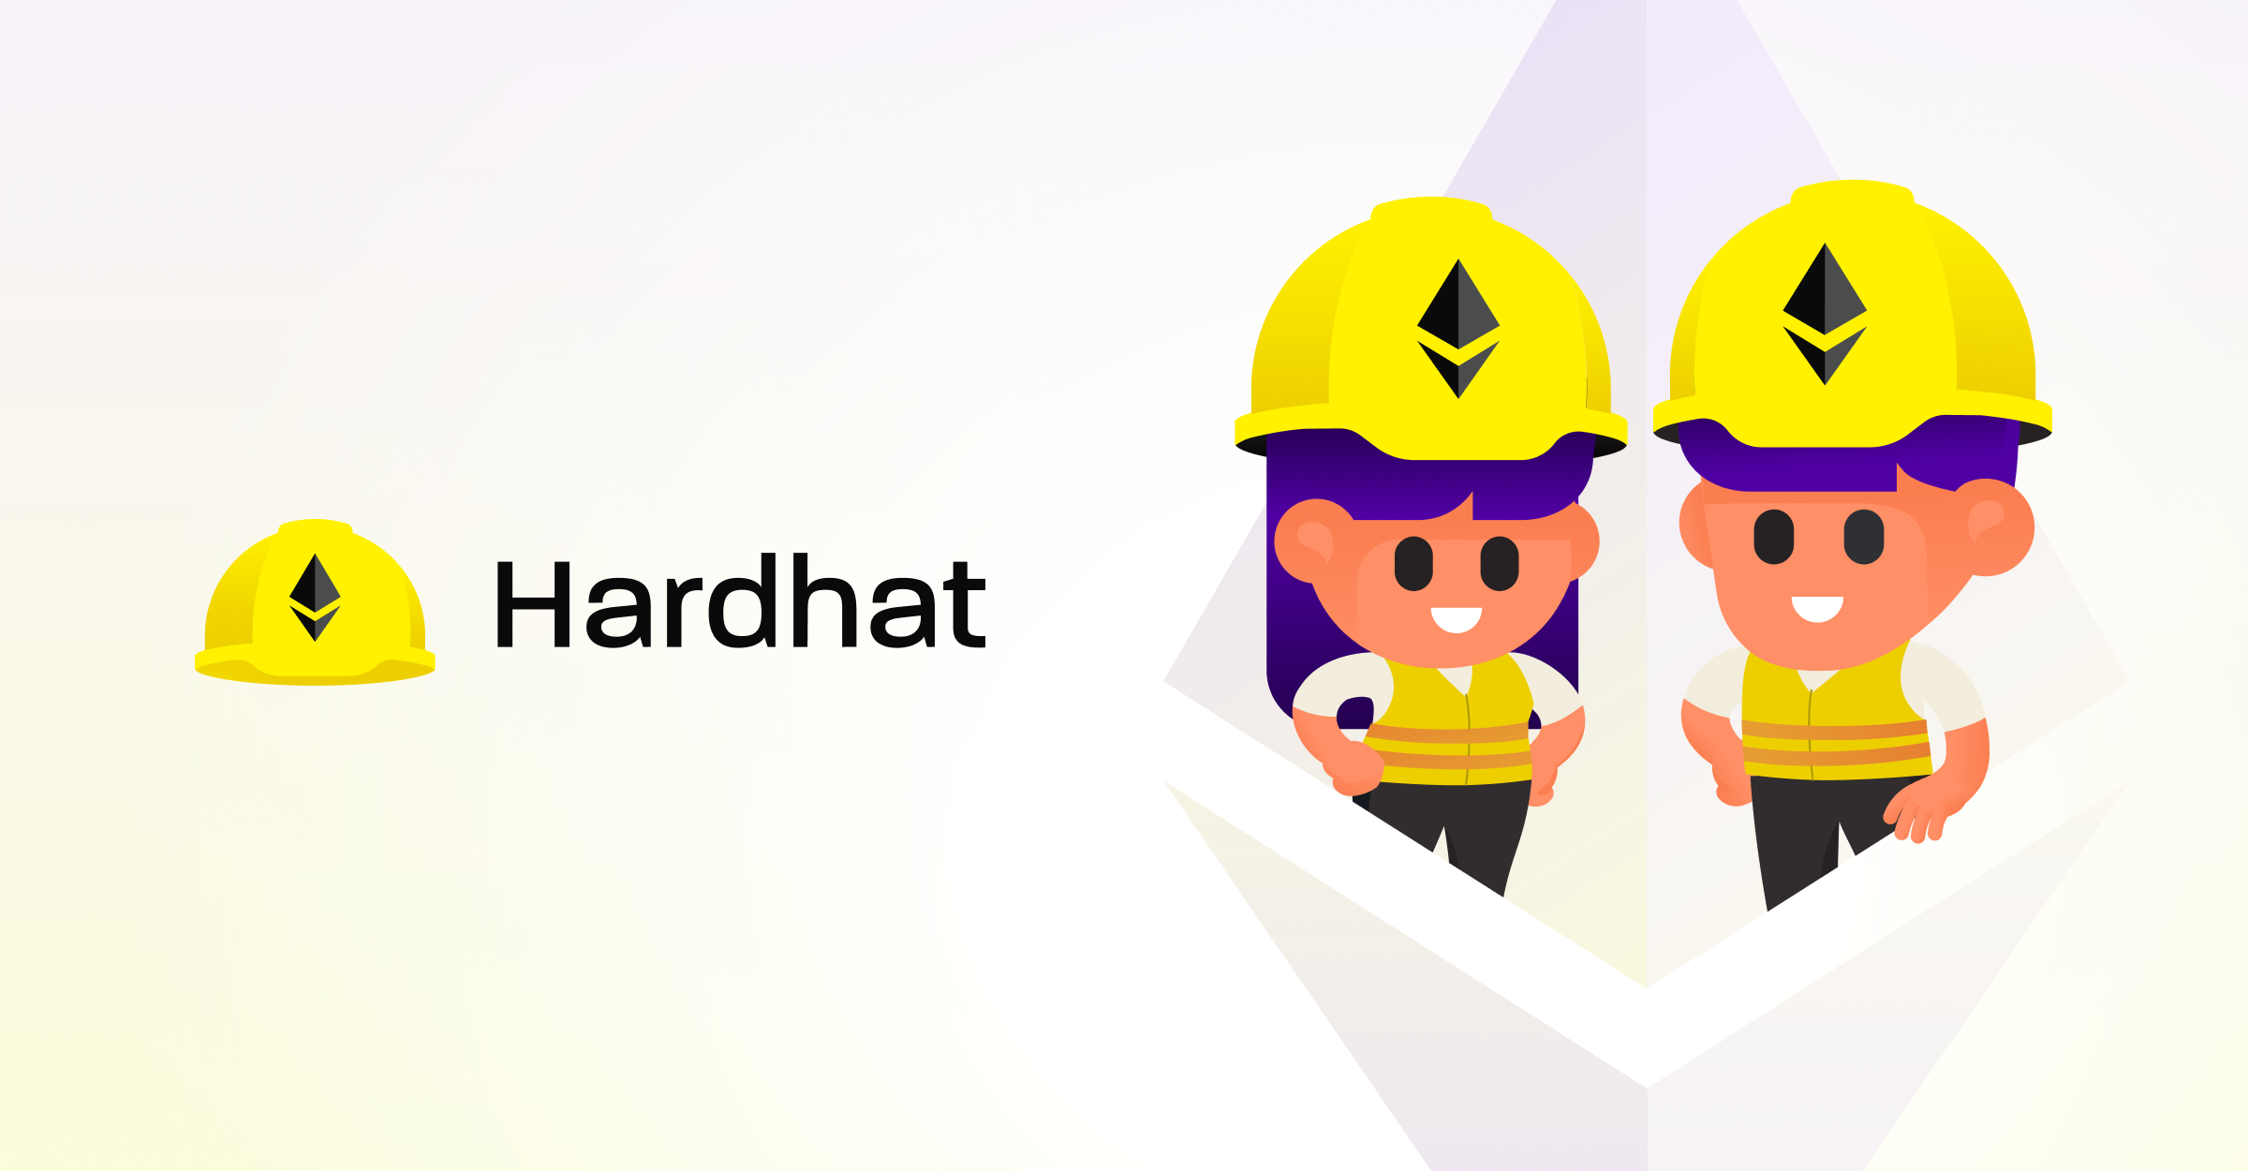
Hard-Hat
Ethereum development environment.

Slide 17

Next.Js
Open source development framework for server-side rendering and generating static websites.

Slide 18

Tailwind CSS
Utility-first CSS framework for rapidly building custom user interfaces on the web.

Slide 19
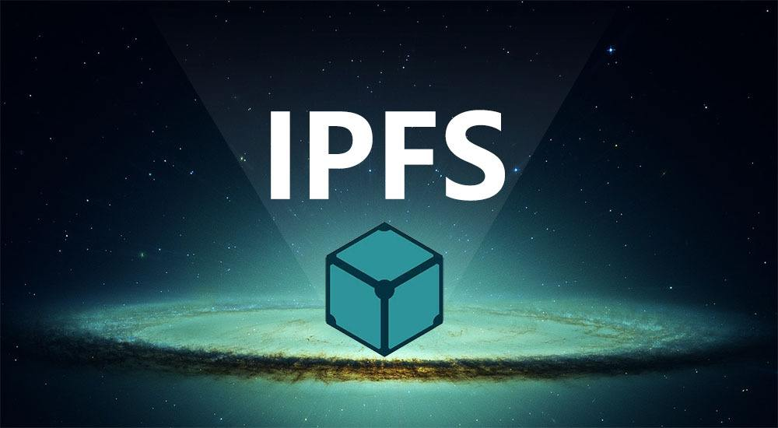
IPFS(Interplanetary File System)
protocol and P2P network for storing and sharing data in a distributed file system.

Slide 20

Meta-Mask
software cryptocurrency wallet used to interact with the Ethereum blockchain.

Slide 21
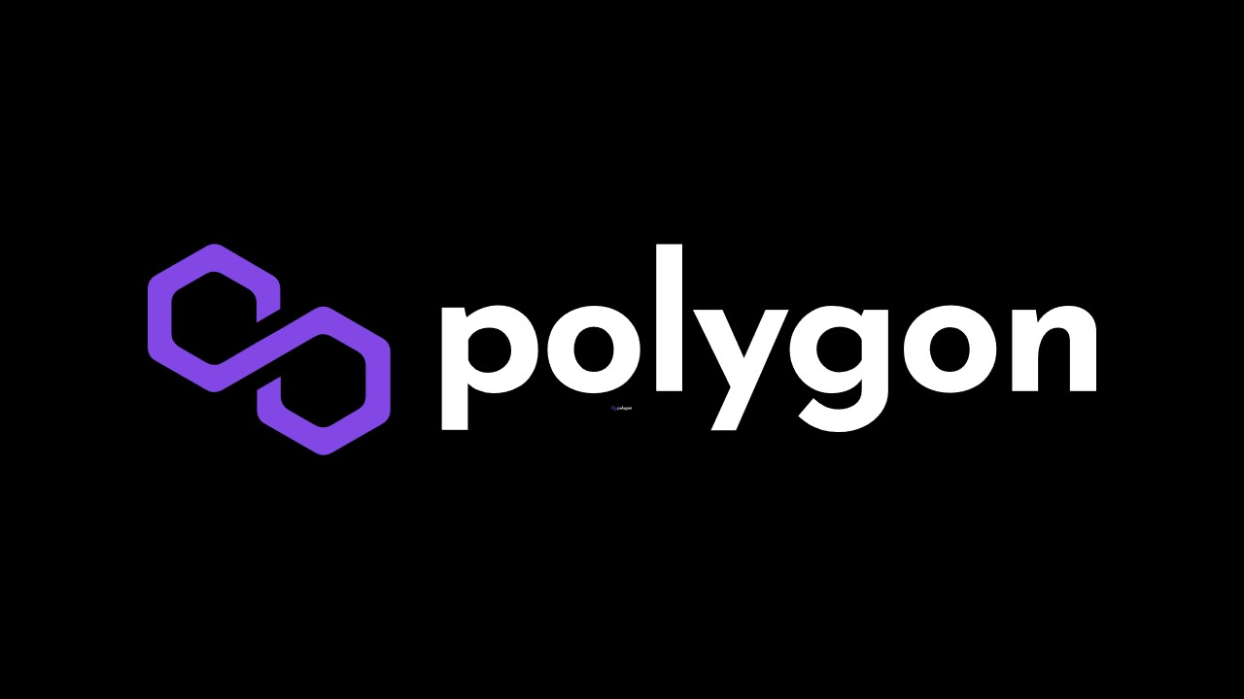
Polygon
framework for building and connecting Ethereum-compatible blockchain networks.

Slide 22
Project Methodology
5
How we will do the project

Slide 23
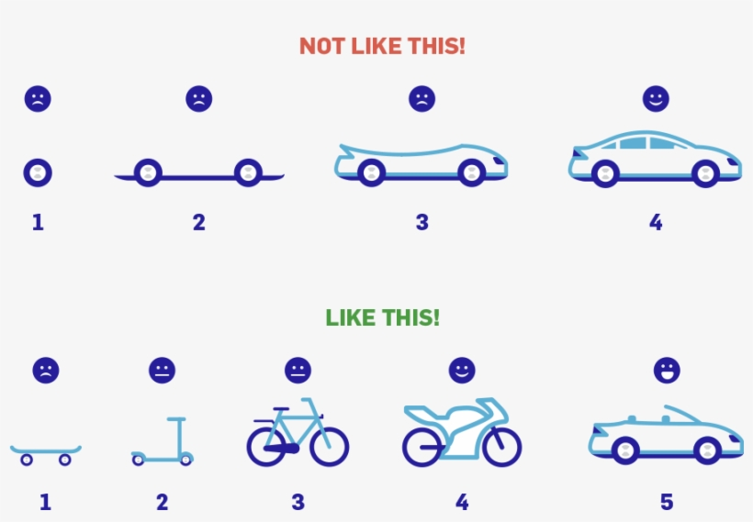
Methodology
Requirements
Plan
Code
Develop
Test
Revise and analyze for improvements

Slide 24
Risk-Cost Analysis
6
Possible Risks Of Project

Slide 25
Risk analysis
Risk of Personnel Unavailability
Planning The Budget
Fixed Timeline
Poor Marketing Strategies
Risk Of Unforeseen Road Blocks

Slide 26
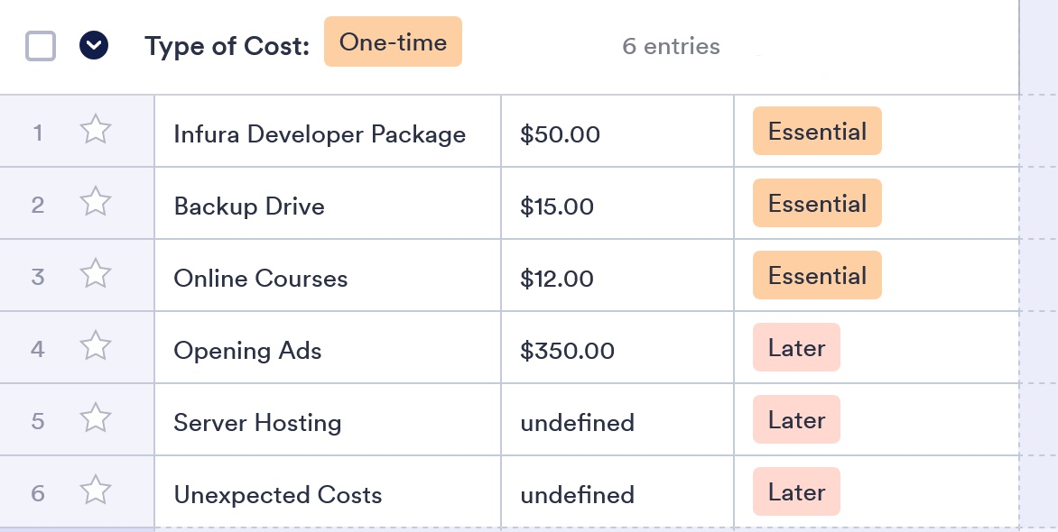
Cost Analysis

Slide 27
Project Timeline
7
Giving a timeline of project processes

Slide 28
Project Timeline
Team Formation
30/10/2020
Problem Definition
17/11/2020
Initialization of Back-end Services and meta-mask
31/11/2020
First Presentations
Dec 2021-January 2022
Start Coding marketplace contracts
January/February 2022
Testing and modification
January 2022 / February 2022
UI work, contract testing, feature addition, server acquisition
February 2022 – July 2022

Slide 29
Possible Outcomes
8
What we hope to achieve

Slide 30
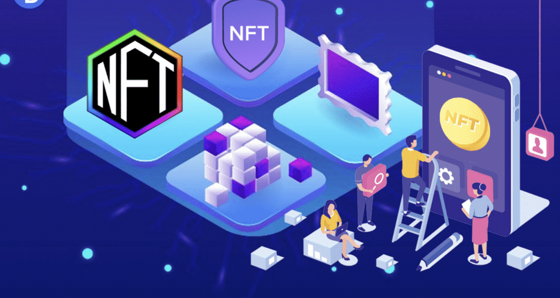
Possible Outcomes
Create fully functional and accessible marketplace UI.
Fortify Transactions with the help of blockchain technology.
Provide an alternative for NFT buyers and sellers in the digital collectible marketplace.

Slide 31
RESOURCES AND EXTRA READING
https://www.ibm.com/topics/what-is-blockchain
https://www.nbcnews.com/tech/tech-news/nft-boom-digital-collectibles-rcna430
https://www.securities.io/non-fungible-tokens-nfts-continue-to-reshape-the-blockchain-market/
http://satoshinakamoto.me/bitcoin.pdf

Slide 32
END OF PRESENTATION
Thank you for your attention!

